Slide 1
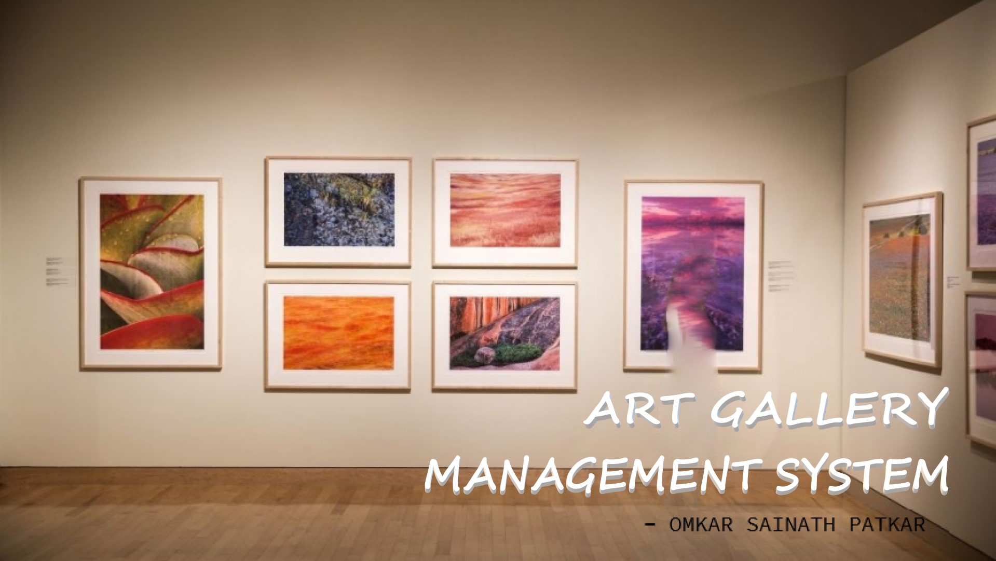

Slide 2
An online Art Gallery Management System created using databases.
Types of databases implemented
RDBMS
ODBMS
MULTIMEDIA DB
XML DB

Slide 3
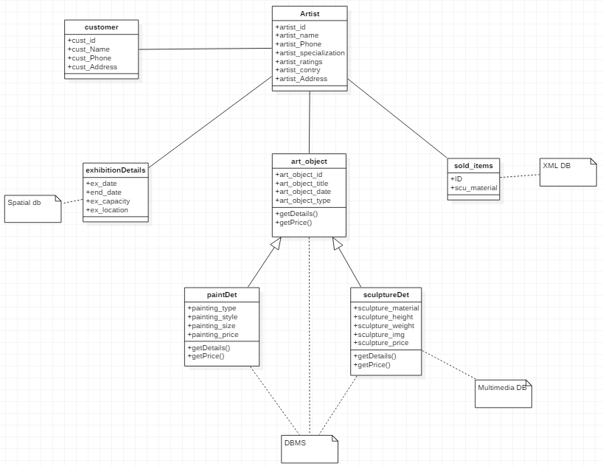
Class Diagram

Slide 4
ODBMS Structure
# Types of Art Objects
* Paintings
Such as Landscape, Abstract, Portrait, Modern Art etc.
* Sculpture
Such as Metal, Bronze, Plaster, Ceramic, Clay etc.

Slide 5
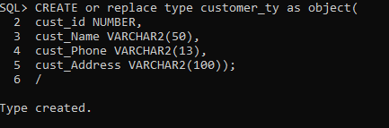
Creating Customer Type

Slide 6
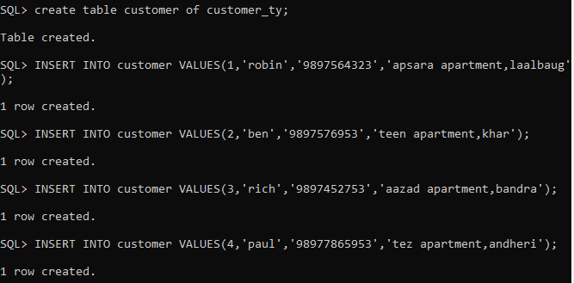
Insertion of customer records

Slide 7
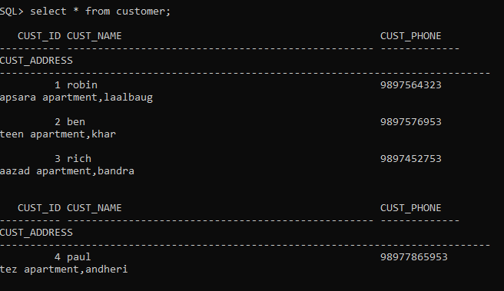
Displaying data of customer

Slide 8
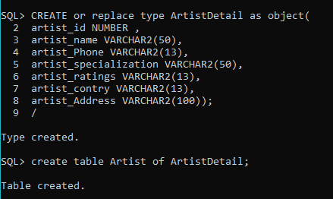
Creating ArtistDetails Type

Slide 9
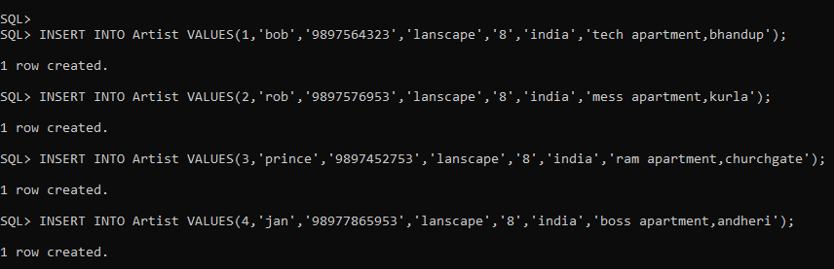
Insertion of Artist records

Slide 10
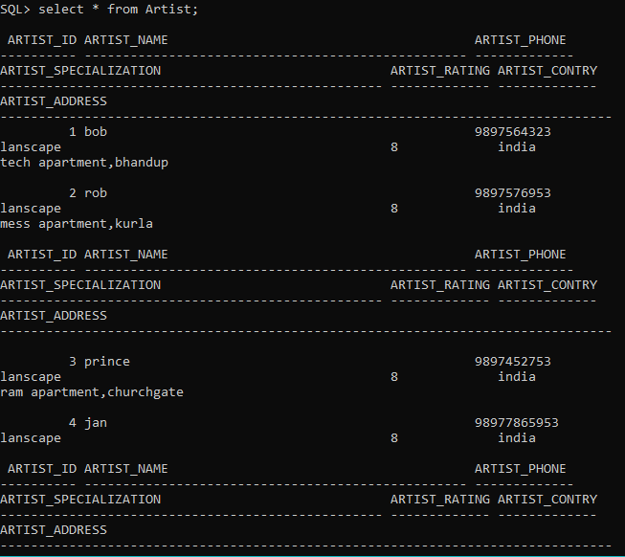
Displaying data of Artist

Slide 11
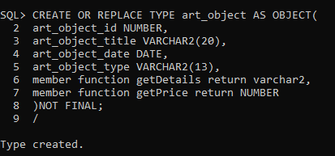
Creating Parent Type art_object

Slide 12
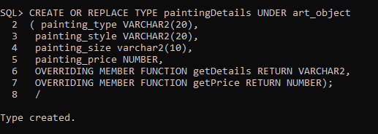
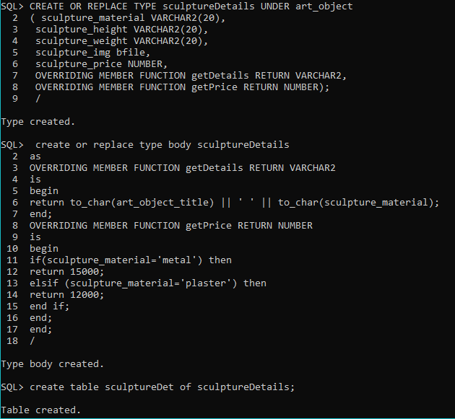
Creating child types
paintingDetails
SculptureDetails

Slide 13
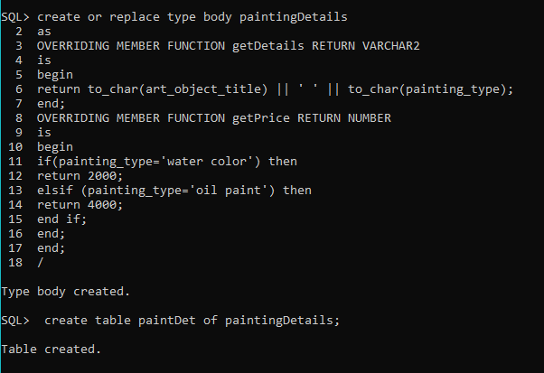
PaintingDetails body

Slide 14
SculptureDetails body

Slide 15
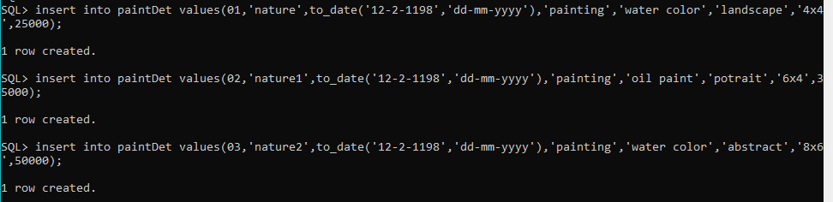
Insertion of records in paintDet

Slide 16
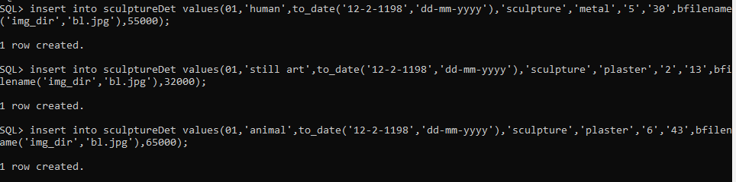
Insertion of records in sculptureDet

Slide 17
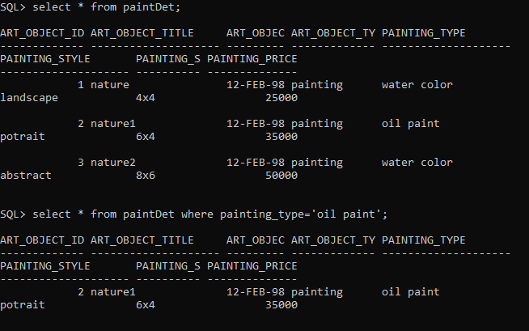
Displaying data of paintDet

Slide 18
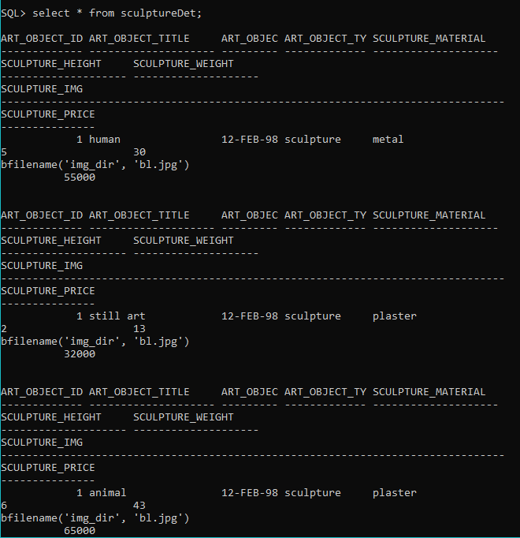
Displaying data of sculptureDet

Slide 19
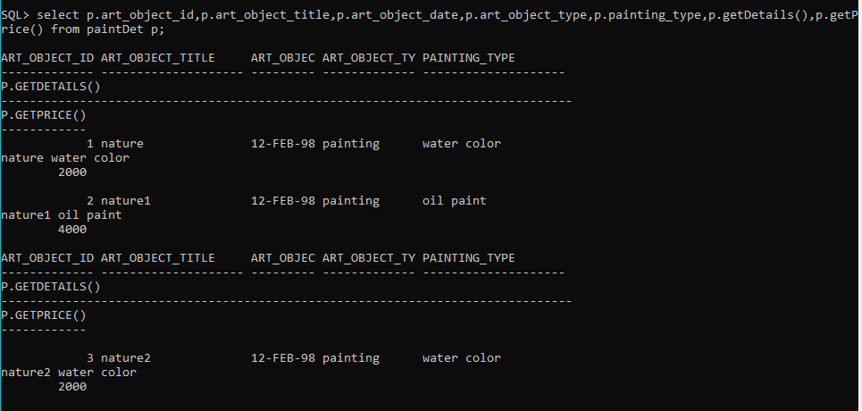
To get details and price of paintings

Slide 20
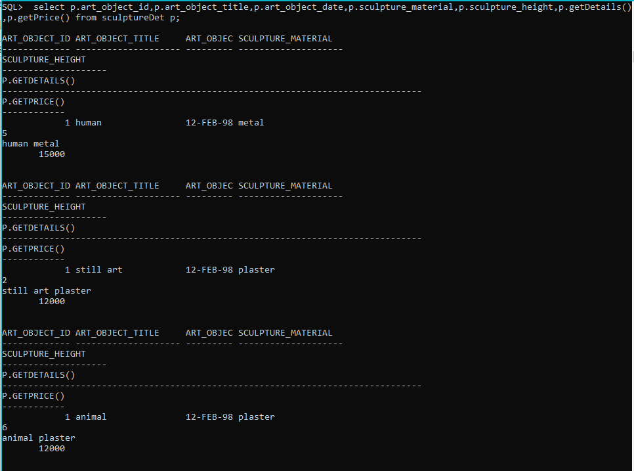
To get details and price of sculpture

Slide 21
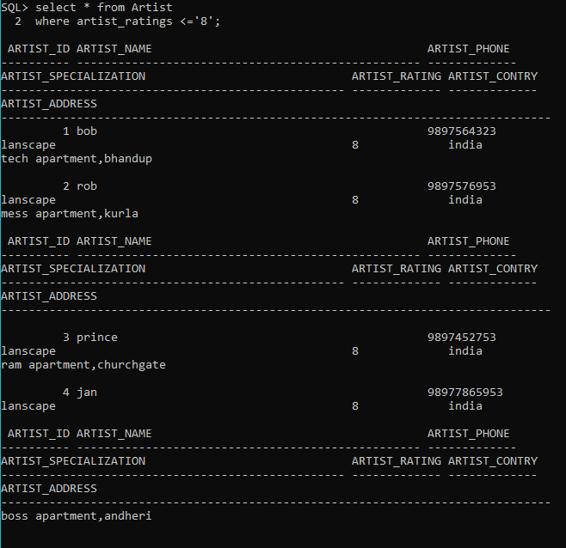
QUERIES
Select * from Artist where artist_rating <= ‘8’;

Slide 22
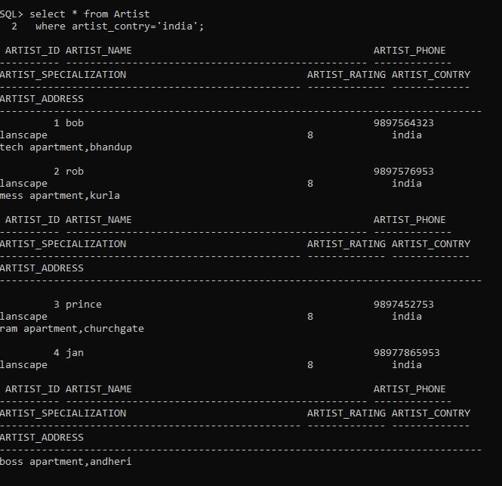
Select * from Artist where artist_contry = ‘india’;

Slide 23
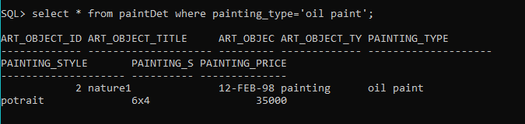
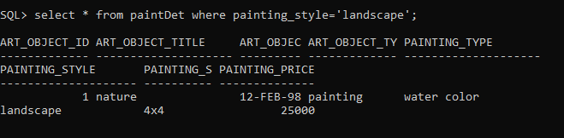
Select * from paintDet where painting_type = ‘oil painting’;
Select * from paintDet where painting_style = ‘landscape’;

Slide 24
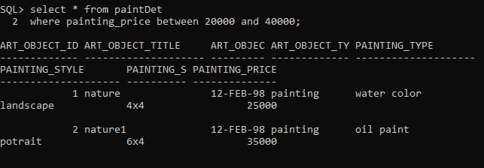
Select * from paintDet where painting_price between 20000 and 40000;

Slide 25

MULTIMEDIA DB
Creating Directory

Slide 26
inserting the records

Slide 27
Displaying the records

Slide 28
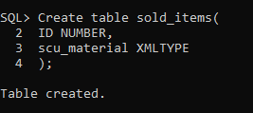
XML DB
Creating table sold_items

Slide 29
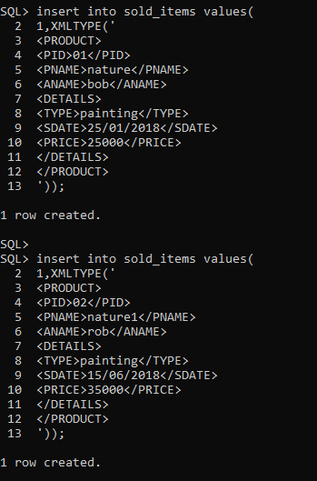
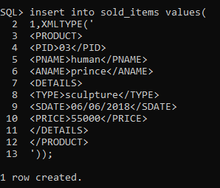
Inserting records in sold_items

Slide 30
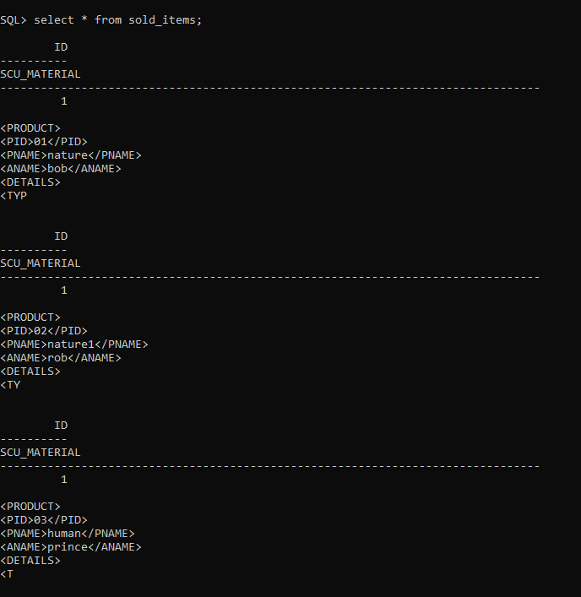
View sold_items

Slide 31
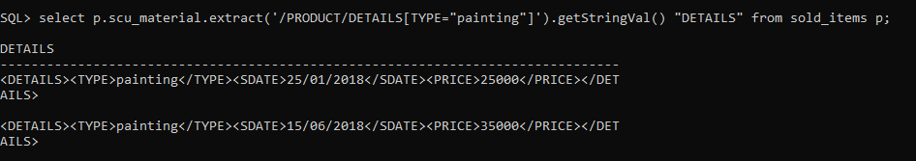
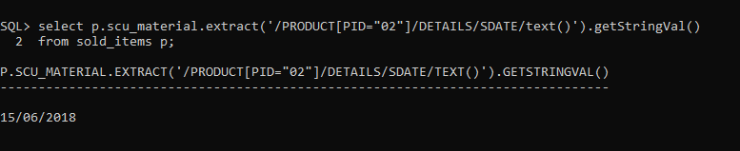
QUERIES
Extract XML Fragment for details of product with TYPE='painting'
Display the date on which product ‘02’ was sold.

Slide 32


